Slide 1


Experimental Design Analysis
Effect of caffeine on Heart rate and Sleep

Slide 2
Research Outline
Introduction
Statement of the problem
Literature review
Research question and Hypothesis
Method of collecting data and Procedure of experiment
Methodology and Data analysis
Discussion and Recommendation
References
Appendix

Slide 3
Introduction
Many studies have looked at the effects of coffee, and some have looked at the effects of tea and soft drinks. None of these studies has offered any evidence to suggest that different sources of caffeine affect us in different ways in general, caffeine affects the cardiovascular system in several ways: In people who don't consume caffeine very often, it can cause systolic blood pressure to rise in the short term by as much as 10 points. In habitual caffeine consumers, this effect is much less pronounced. Caffeine can act on enzymes in the heart that stimulate the intensity of the heart's contractions. Caffeine can facilitate the release of natural hormones that act on the heart to release norepinephrine, which can produce a stimulating effect similar to that of adrenaline. At higher levels, caffeine can increase the amount of calcium inside the cells in the heart. Since all of the cells involved in the hearts squeezing and relaxing are regulated by calcium, an increase can affect the heart's pumping action Glickman (2010).

Slide 4
Statement of the problem
Several studies have evaluated the problematic issues of taking a lot of doses of caffeine and its effects on heart rate and sleep. Several effects are by blocking the effects of adenosine, a brain chemical that makes you feel tired. At the same time, it triggers the release of adrenaline, the “fight-or-flight” hormone associated with increased energy, also causes insomnia i.e., higher caffeine intake appears to increase the amount of time it takes to fall asleep. It may also decrease total sleeping time, especially in the elderly. Another effect is the breaking down of muscles i.e., Rhabdomyolysis which is a very serious condition in which damaged muscle fibers enter the bloodstream, leading to kidney failure and other problems. caffeine doesn’t seem to increase the risk of heart disease or stroke in most people. However, it has been shown to raise blood pressure in several studies due to its stimulatory effect on the nervous system.

Slide 5
Literature review
Caffeine promotes alertness during times of desired wakefulness in persons with jet lag or shift work disorder (for a review see Lorist and Snel, 2008). An important benefit of the effects of caffeine could be a reduced risk of injury and error during these periods. Tieges et al. (2004) showed that doses of 3 and 5 mg/kg body weight of caffeine in well-rested habitual caffeine consumers indeed reduced the number of errors compared to a placebo condition. Based on related changes in brain activity shown as enlarged error-related negativity, an event-related brain component that reflects anterior cingulate cortex activity, they concluded that coffee consumption increased monitoring of ongoing cognitive processes for signs of erroneous outcomes.
The observed reduction in self-consciousness resulting in overconfidence after caffeine consumption seems to contradict these findings and might have consequences in real-life environments. Realistic self-perception is essential in avoiding risks. The important question of whether under suboptimal conditions, for example, due to extended wakefulness, caffeine is still able to enhance the detection of erroneous responses and consequently minimize the risk of errors, was extensively studied in recent years (e.g., Lorist and Snel, 2008). Ker et al. (2010) examined more specifically the role of caffeine in preventing errors or injuries caused by impaired alertness in individuals with jet lag or shift work.

Slide 6
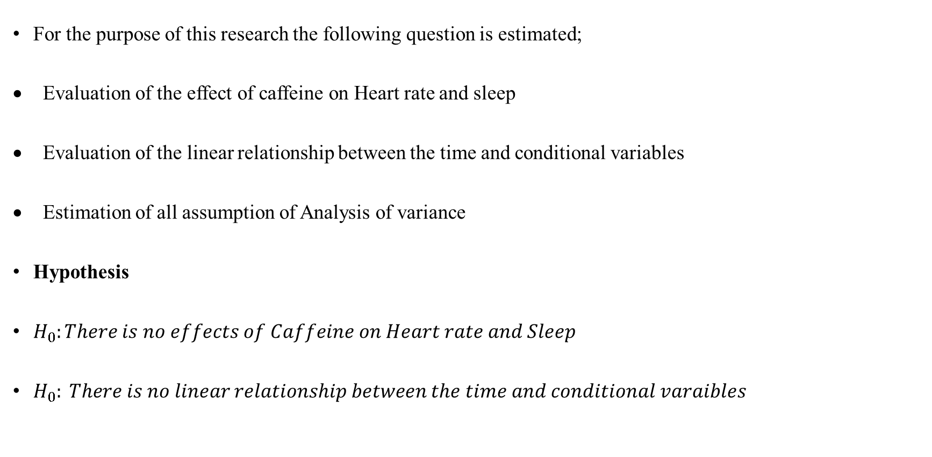
Research question and hypothesis
For the purpose of this research the following question is estimated;
Evaluation of the effect of caffeine on Heart rate and sleep
Evaluation of the linear relationship between the time and conditional variables
Estimation of all assumption of Analysis of variance
Hypothesis
$H_{0}:There is no effects of Caffeine on Heart rate and Sleep$
$H_{0}: There is no linear relationship between the time and conditional varaibles$

Slide 7
Method of collecting data and Procedure of experiment
The data is extracted and calculated using the Huawei GT2 pro watch and Huawei health app to monitor the heart rate and sleep. The sleep rate is regulated on 20 participants on 220-250gram of coffee, tea, and energy drink on 0hrs, 3hrs, 6hrs before bedtime while the heart rate is measured 15 mins before drinking coffee, tea, and energy drink, another 15 mins which equal 30 mins after drinking coffee and another 15 mins which equal 45mins after drinking coffee, tea, and energy drink on 10 participants.
Procedure
The 20 Participants went to bed with the HUAWEI WATCH GT 2 Pro on their wrist! The watch automatically detects when they have fallen asleep, track their sleep stages and heart rate (such as REM, light, and deep sleep), and sense, when they have woken up likewise the HUAWEI Health app, was open on phone i.e., Devices > HUAWEI WATCH GT 2 Pro, and toggle off HUAWEI TruSleep and Heartrate. Caffeine is of 4 levels (Coffee, tea, energy drink, non-caffeine (coffee, tea, drinks). Coffee used: Turkish coffee and American coffee, Tea: Sage, Ginger, and Herbal tea. Energy drink: Monster energy and Red bull. Non-caffeine: Golden milk tea, Lemon drink, and Vanilla. Health rate is measured in bpm and sleep in seconds’ scale.

Slide 8
Methodology and Data Analysis
Factorial design with repeated measures
A factorial repeated measures ANOVA (or two-way repeated-measures ANOVA) is quite similar to a factorial ANOVA with the difference that there is a dependency between groups in the data set like in a repeated-measures ANOVA. This means that subjects have been measured repeatedly in time or in different circumstances or treatments.
Assumptions
The assumptions are:
each individual is represented in the form of measurement in each of the tested groups (there cannot be any missing value),
normality of distribution (use the Shapiro-Wilk),
sphericity, which means that equality of variance is verified when comparing any two groups (all possible pairs of groups) in the experimental design (commonly checked via Mauchly’s test),
groups contain no outliers.

Slide 9
Methodology and Data Analysis contd
Testing of ANOVA Assumption
Conclusion
The Kolmogorov – Smirnov test of normality shows that the assumption of normality is valid since all the p value > 0.05.
The point are closer to the straight line, thus the assumption of normality is valid.

Slide 10
Methodology and Data Analysis contd

Slide 11
Discussion and Recommendation
Discussion
After thorough analysis from the experiment which was carried out to see the effect of caffeine such as Coffee, tea, energy drink and Non-caffeine (drink, tea or coffee) on sleep and Heart rate with a specified time interval of repeated measures, the results shows that there is no statistically significant of the caffeine intake on Heart rate but the time estimation of taking the caffeine does have a significant relationship or effect on the Heart rate. In addition, the results also show that there is statistically significant of the caffeine intake on sleep and the time of estimation does have significant relationship on the sleep.
Recommendation.
I will recommend based on the caffeine material used the Turkish coffee, American coffee, Sage tea, herbal tea and ginger tea, likewise the drinks the Red bull etc and finally the non-caffeine drinks vanilla etc. I suggest and recommend user who might be addicted to the intake of this caffeine material should reduce its content, the effect on sleep might lead to insomnia, high blood pressure and the rest.

Slide 12
References
Dagan, Y., & Doljansky, J. T. (2006). Cognitive performance during sustained wakefulness: A low dose of caffeine is equally effective as modafinil in alleviating the nocturnal decline. Chronobiology International https://psycnet.apa.org/record/2006-20938-005
Juliano, L. M., & Griffiths, R. R. (2004). A critical review of caffeine withdrawal: Empirical validation of symptoms and signs, incidence, severity, and associated features. Psychopharmacology (Berlin) https://europepmc.org/article/med/15448977
Keane, M. A., & James, J. E. (2008). Effects of dietary caffeine on EEG, performance, and mood when rested and sleep restricted. Human Psychopharmacology: Clinical and Experimental. https://onlinelibrary.wiley.com/doi/abs/10.1002/hup.987
Ker, K., Edwards, P. J., Felix, L. M., Blackhall, K., & Roberts, I. (2010). Caffeine for the prevention of injuries and errors in shift workers. Cochrane Database of Systematic Reviews, 5, CD008508 https://pubmed.ncbi.nlm.nih.gov/20464765/
Lorist, M. M., & Tops, M. (2003). Caffeine, fatigue, and cognition. Brain and Cognition. https://pubmed.ncbi.nlm.nih.gov/14572506/
Tieges, Z., Richard Ridderinkhof, K., Snel, J., & Kok, A. (2004). Caffeine strengthens action monitoring: Evidence from the error-related negativity. Brain Research. Cognitive Brain Research https://pubmed.ncbi.nlm.nih.gov/15325416/
Ty Gluckman, D (2010): How does caffeine affect the heart and sleep https://oregon.providence.org/physician-directory/g/gluckman-ty-j

Slide 13
Appendix

Slide 14
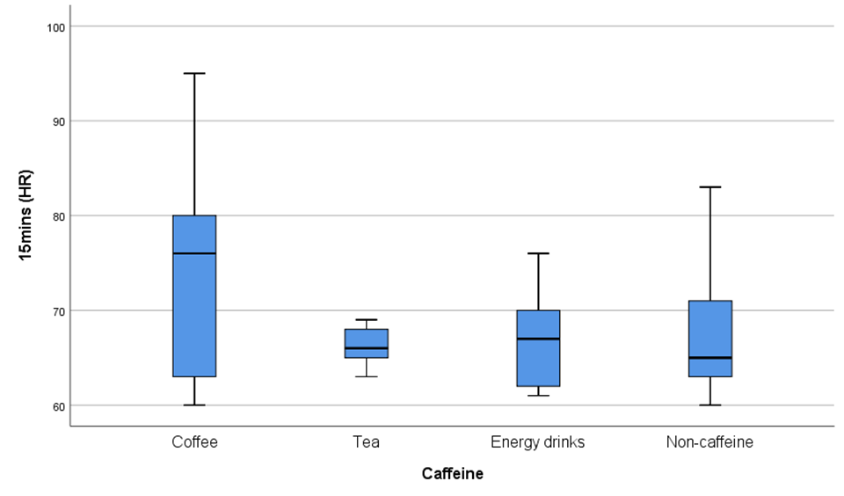
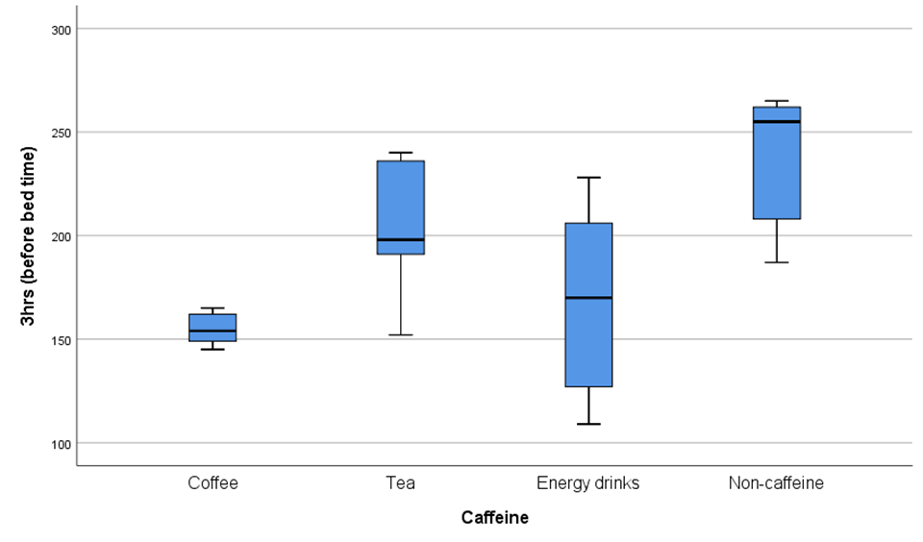
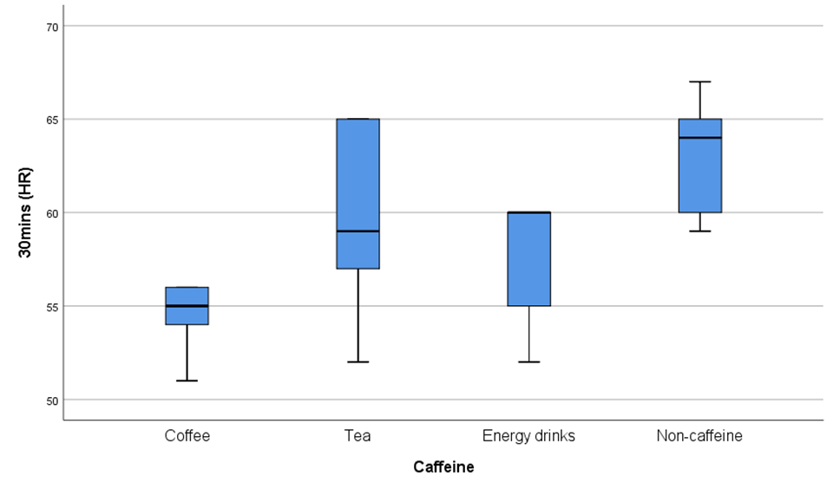
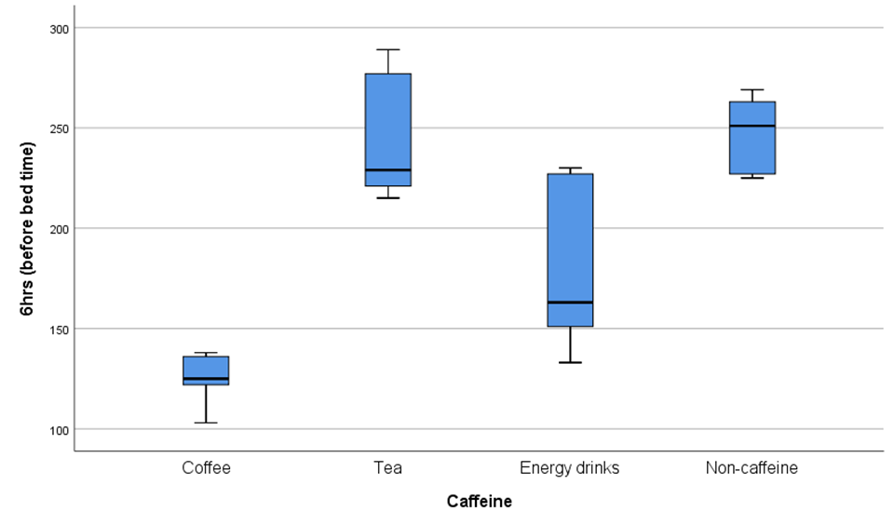
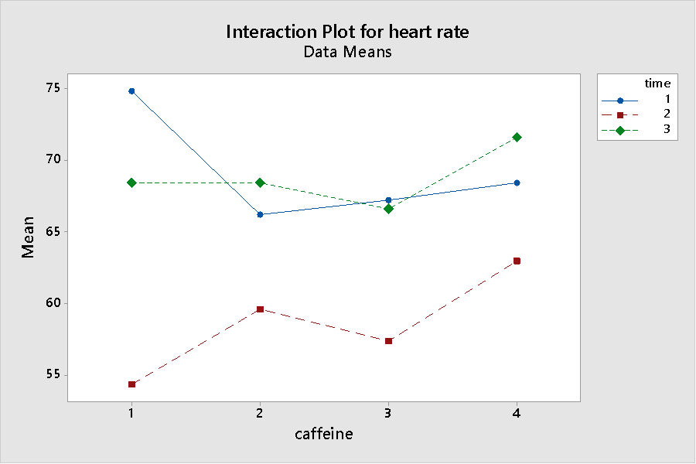
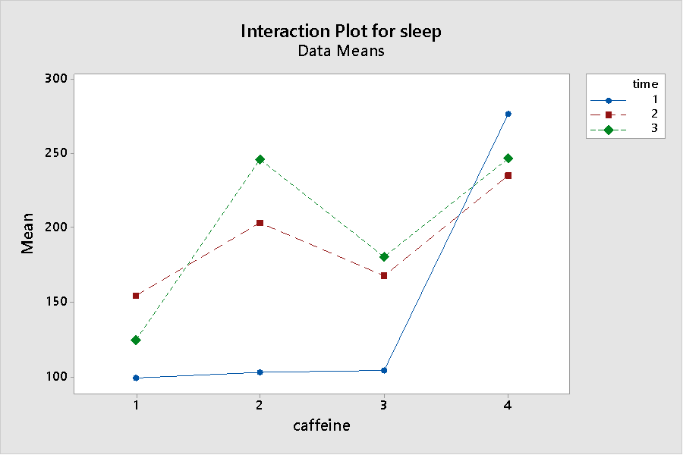
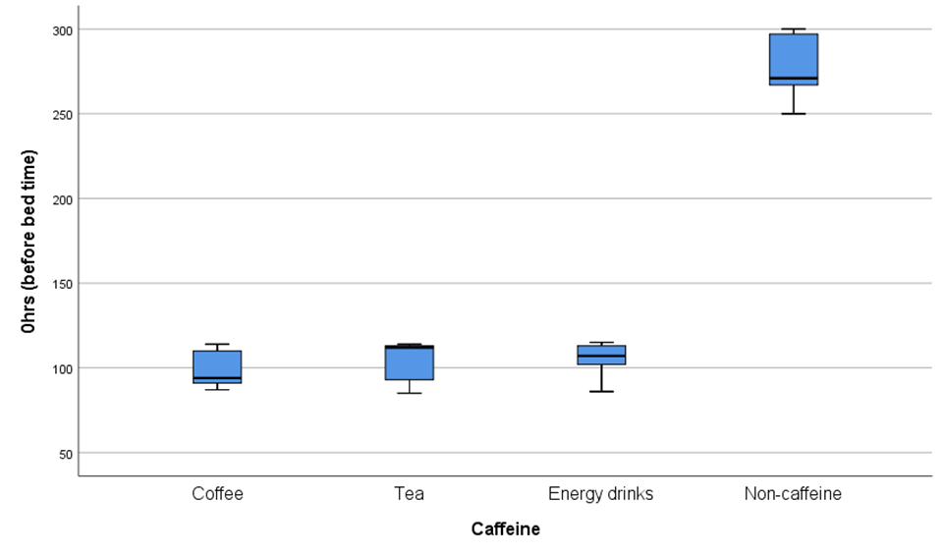
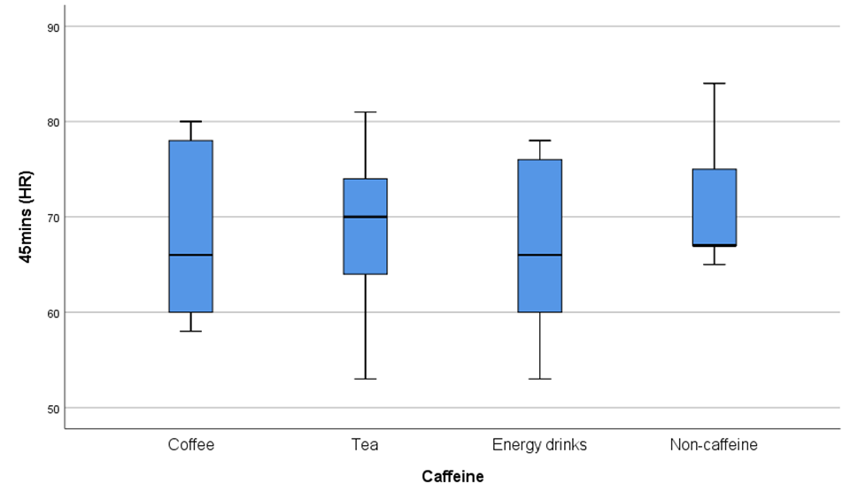
Appendix contd.

